Slide 1
Breast Cancer analysis
CAPSTONE PROJECT
Presented By:
S. Fathima Feronzia
College Name: SCAD College of Engineering and Technology
Department: Electrical And Electronics Engineering

Slide 2
OUTLINE
Problem Statement
Proposed System/Solution
System Development Approach
Algorithm & Deployment
Result
Conclusion
Future Scope
References

Slide 3
Problem Statement
Breast cancer is a significant health concern worldwide, with early detection playing a crucial role in successful treatment outcomes. The problem statement for this data science project is to develop a machine learning model capable of accurately diagnosing breast cancer.During their life, among 8% of women are diagnosed with breast cancer after lung cancer. breast cancer is characterized by the mutation of genes, constant pain, changes in the size, colour(redness), skin texture of breasts Established methods of detecting and diagnosing cancer mainly depend on skilled physicians, with the help of medical imaging, to detect certain symptoms that usually appear in the later stages of cancer. This project presents a novel method to detect breast cancer by employing techniques of Machine Learning.

Slide 4
Proposed Solution
I will making a Machine Learning model which will be using a dataset to classify the breast cancer into two types.
1) Malignant 2) Benign
We will be using advance classification and optimization methods for increasing the accuracy of our predicting model.
In my model I able to classify the cancer in to the above given types with high accuracy on the set of data given by the client.
I implement different M.L algorithms and evaluate their accuracy using cross validation technique to find the best model by combining feature pre-processing methods and classifier algorithms like Logistic Regression, Decision Tree, Random forest, K-nearest Algorithm, SVM.
Block diagram :
Dataset
Pre-processing data
Building Model and split data
Training
data
Testing
data
Result

Slide 5
System Approach
Data collection is the process of gathering and measuring information on variables of interest in an established systematic fashion that enables one to answer stated research questions, test hypotheses and evaluate outcomes.
Clean and preprocess the data to handle missing values, outliers and ensure data consistency.
Engineer new features or transform existing ones to enhance the predictive power of the model.
Develop and train machine learning models, including but not limited to logistic regression, decision trees, random forests, support vector machines or convolutional neural networks for image-based data.
Evaluate the performance of the developed models using appropriate evaluation metrics such as accuracy, precision, recall, F1-score and ROC curves.
Interpret the trained models to understand the importance of different features in diagnosing breast cancer. Utilize visualization techniques to explain model predictions.
Deploy the best-performing model into a user-friendly interface or integrate it into existing healthcare systems for real-time diagnosis.

Slide 6
Algorithm & Deployment
Data Collection:
Accurate data collection is essential to ensure the integrity of the research, regardless of the field of study or data preference.
The goal for all data collection is to capture quality evidence that allows analysis to lead to the formulation of convincing and credible answers to the questions that have been posed.
In our project is we are using WISCONSIN (Diagnostic) Data Set for Breast Cancer provided by UCI Machine Learning Repository.

Slide 7
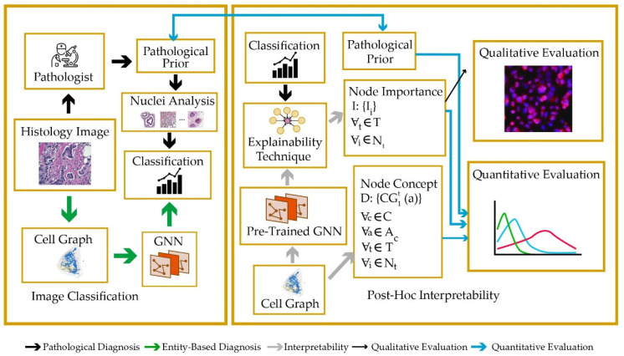

Slide 8
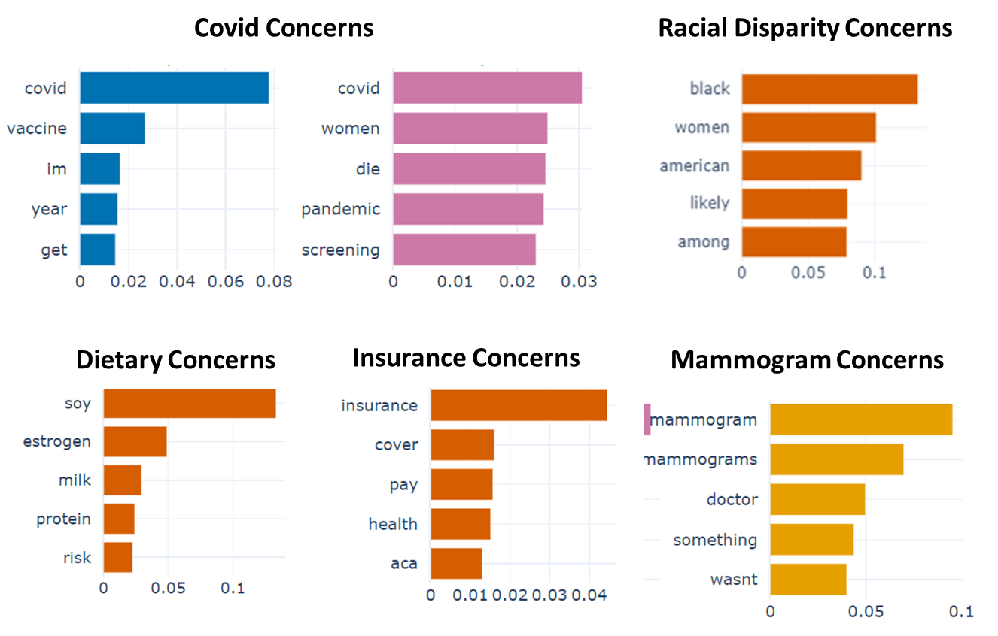
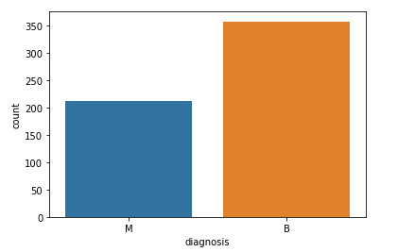

Slide 9
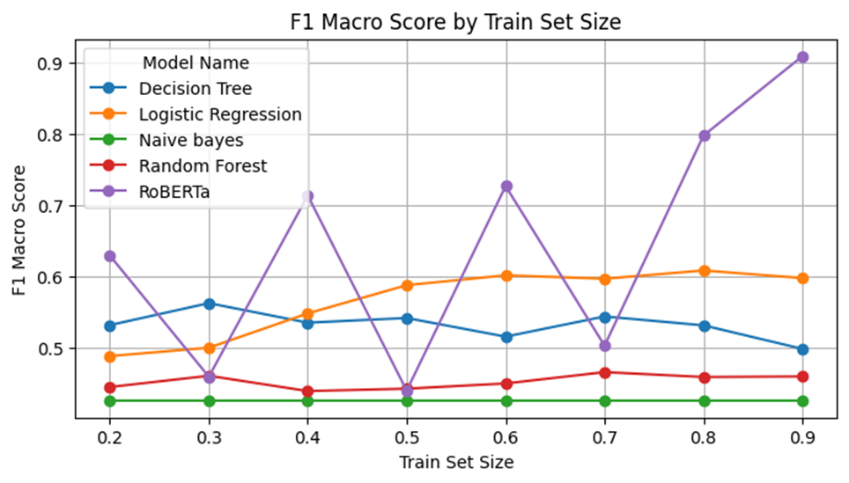
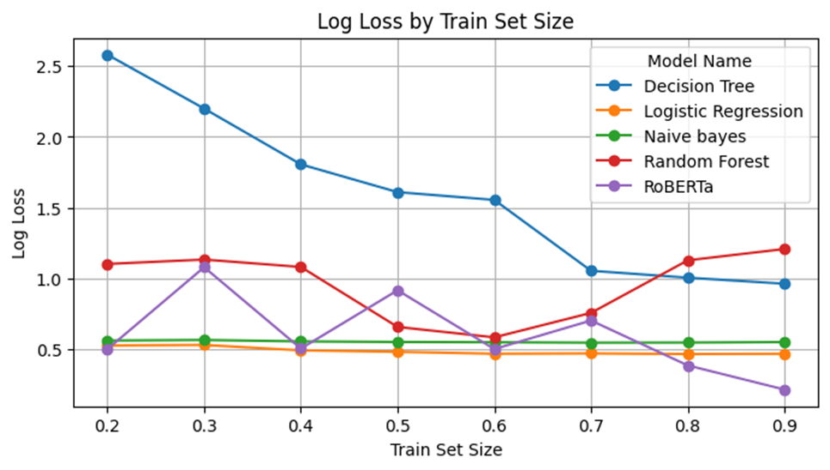

Slide 10
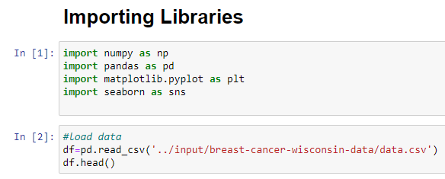
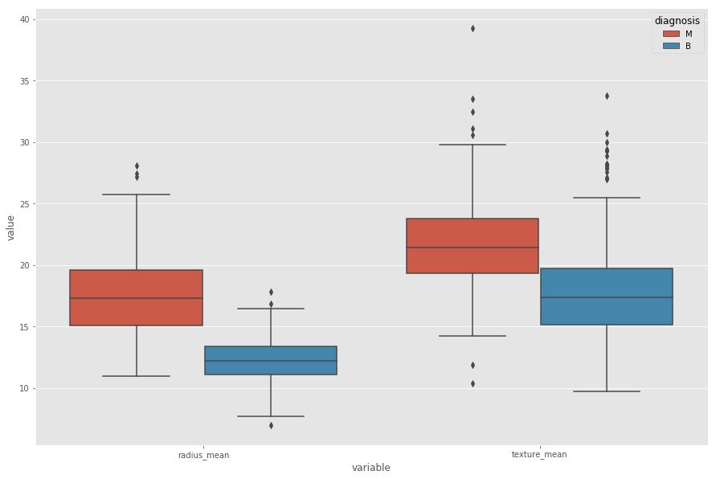

Result
Using required python modules like pandas , numpy for making data frame from dataset and using matplotlib and seaborn for Visualization and sklearn for model building.

Slide 11
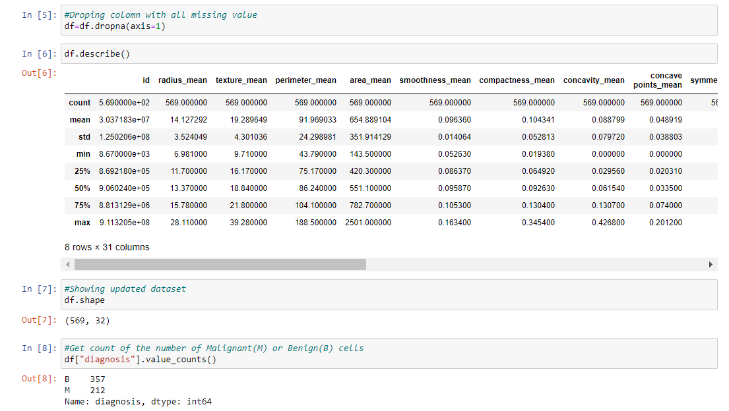
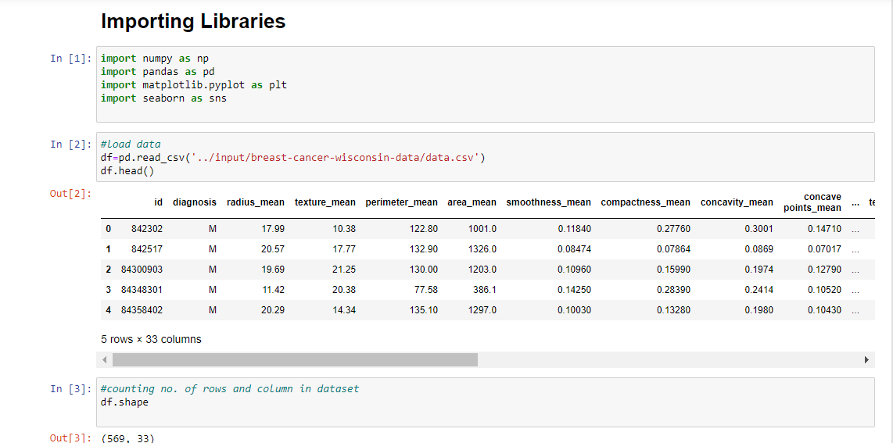
Result

Slide 12
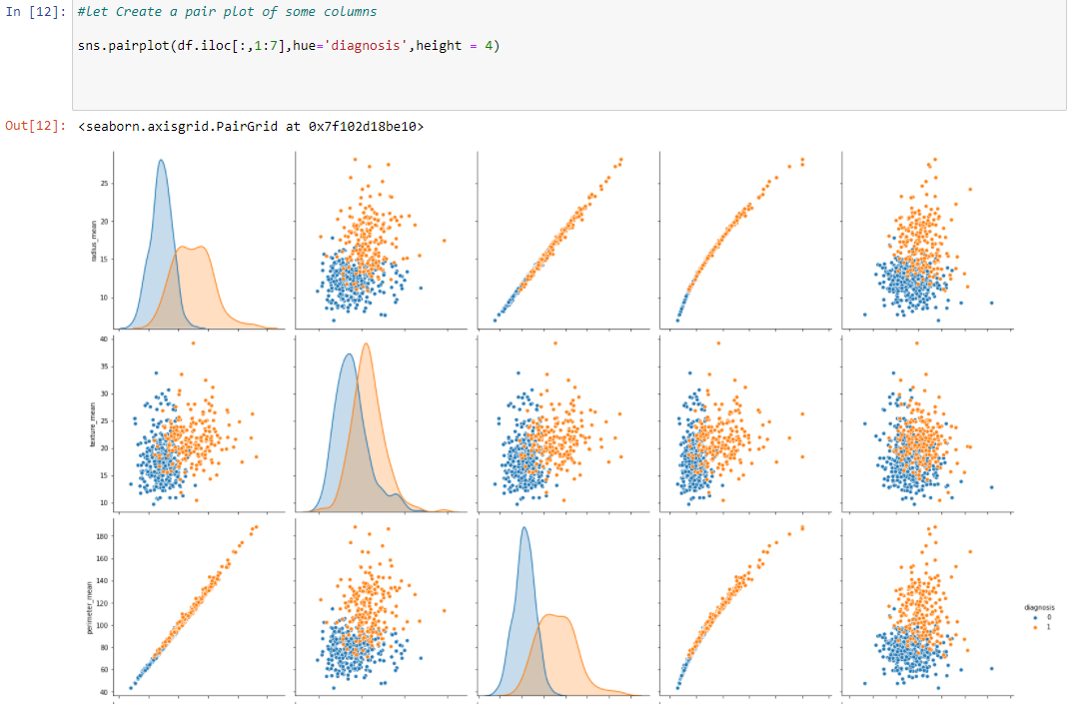
Result

Slide 13
#Split the dataset into X and Y
X=df.drop(["diagnosis"],axis=1)
Y=df["diagnosis"]
#split data set into 75% training and 25% test dataset
from sklearn.model_selection import train_test_split
X_train,X_test,Y_train,Y_test=train_test_split(X,Y,test_size=0.25,random_state=0)
test_id=X_test["id"] #for storing patient id
X_train=X_train.drop(["id"],axis=1)
X_test=X_test.drop(["id"],axis=1)
#feature scaling
from sklearn.preprocessing import StandardScaler
sc=StandardScaler()
X_train=sc.fit_transform(X_train)
X_test=sc.fit_transform(X_test)
#Logistic regression
from sklearn.linear_model import LogisticRegression
log=LogisticRegression(random_state=0)
log.fit(X_train,Y_train)
#Decison tree
from sklearn.tree import DecisionTreeClassifier
tree=DecisionTreeClassifier(criterion="entropy",random_state=0)
tree.fit(X_train,Y_train)
#Random Forest
from sklearn.ensemble import RandomForestClassifier
forest=RandomForestClassifier(n_estimators=10,criterion="entropy",random_state=0)
forest.fit(X_train,Y_train)
#SVM
from sklearn.svm import SVC
svc =SVC()
svc.fit(X_train,Y_train)
#Prediction using XGBoost
from xgboost import XGBClassifier
xgb = XGBClassifier()
xgb.fit(X_train, Y_train)
from sklearn.metrics import classification_report
print("Classification report of Random Forest Classfier :-\n")
cla_rep=classification_report(Y_test, forest.predict(X_test))
print(cla_rep)
Classification report of Random Forest Classfier :-
precision recall f1-score support
0 0.99 0.98 0.98 90
1 0.96 0.98 0.97 53
accuracy 0.98 143
macro avg 0.98 0.98 0.98 143
weighted avg 0.98 0.98 0.98 143

Slide 14
Conclusion
This data science project focused on developing a machine learning-based system for breast cancer analysis, aiming to improve early detection and diagnosis. The results obtained from the evaluation of the developed model demonstrate its effectiveness in accurately diagnosing breast cancer, as evidenced by high accuracy, precision, recall, and F1-score metrics.
The model's performance was further validated through robust evaluation techniques such as cross-validation, ensuring its generalization to unseen data .
Overall, this data science project represents a significant step towards leveraging advanced technologies to address critical healthcare challenges, ultimately contributing to the advancement of medical diagnosis and patient care.

Slide 15
Future scope
Conducting longitudinal studies to analyze patient data over time can provide insights into disease progression, treatment efficacy, and patient outcomes.
Collaborative research initiatives involving interdisciplinary teams of data scientists, clinicians, and domain experts can foster innovation in breast cancer analysis.
Future projects should focus on ensuring the responsible and ethical deployment of AI-driven solutions in healthcare, including issues related to patient privacy, bias mitigation, and model transparency.
By developing scalable and cost-effective solutions, data science projects can contribute to global health initiatives aimed at reducing the burden of breast cancer worldwide.

Slide 16
References
https://www.sciencedirect.com/science/article/pii/S2405959520300801
https://www.researchgate.net/publication/319688741_Breast_Cancer_Prediction_Using_Data_Mining_Method

Slide 17
THANK YOU

